Slide 1
NE 763: Advanced Reactor Materials
Fall 2026
Dr. Benjamin Beeler

Slide 2
advanced cladding

Slide 3
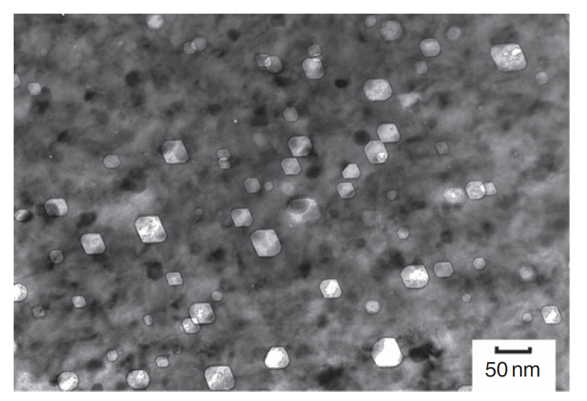
The need for advanced cladding
Austenitic stainless steels are widely used as structural components in nuclear service
At high dose, the microstructure develops a high concentration of voids, leading to dramatic swelling
Swelling of cladding in FFTF and BN-600
Void swelling in 304SS

Slide 4
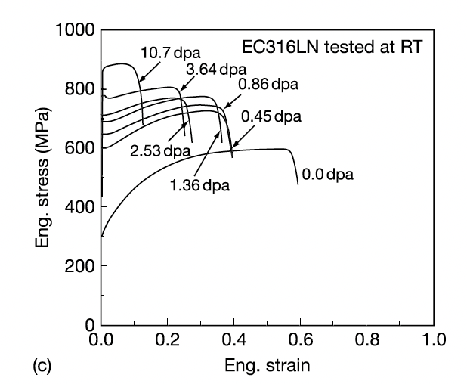
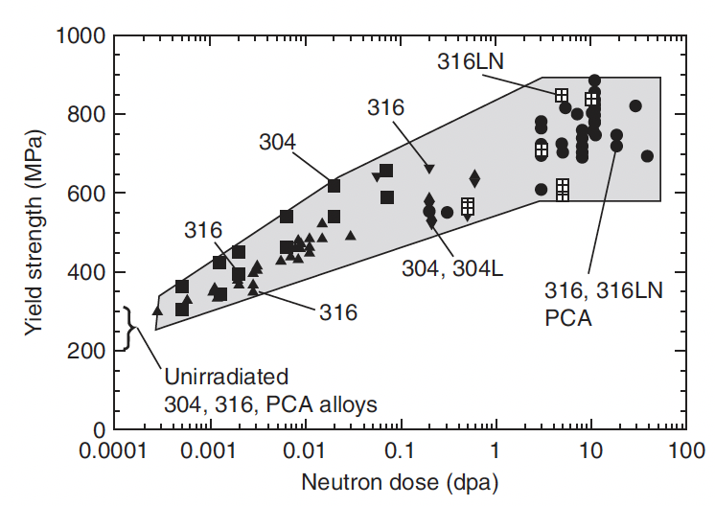
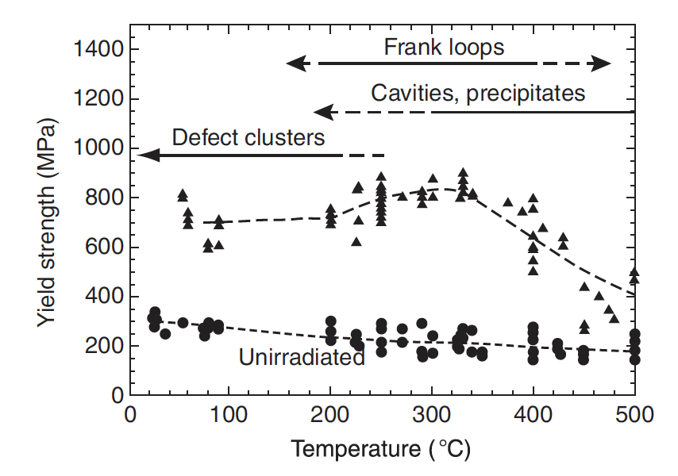
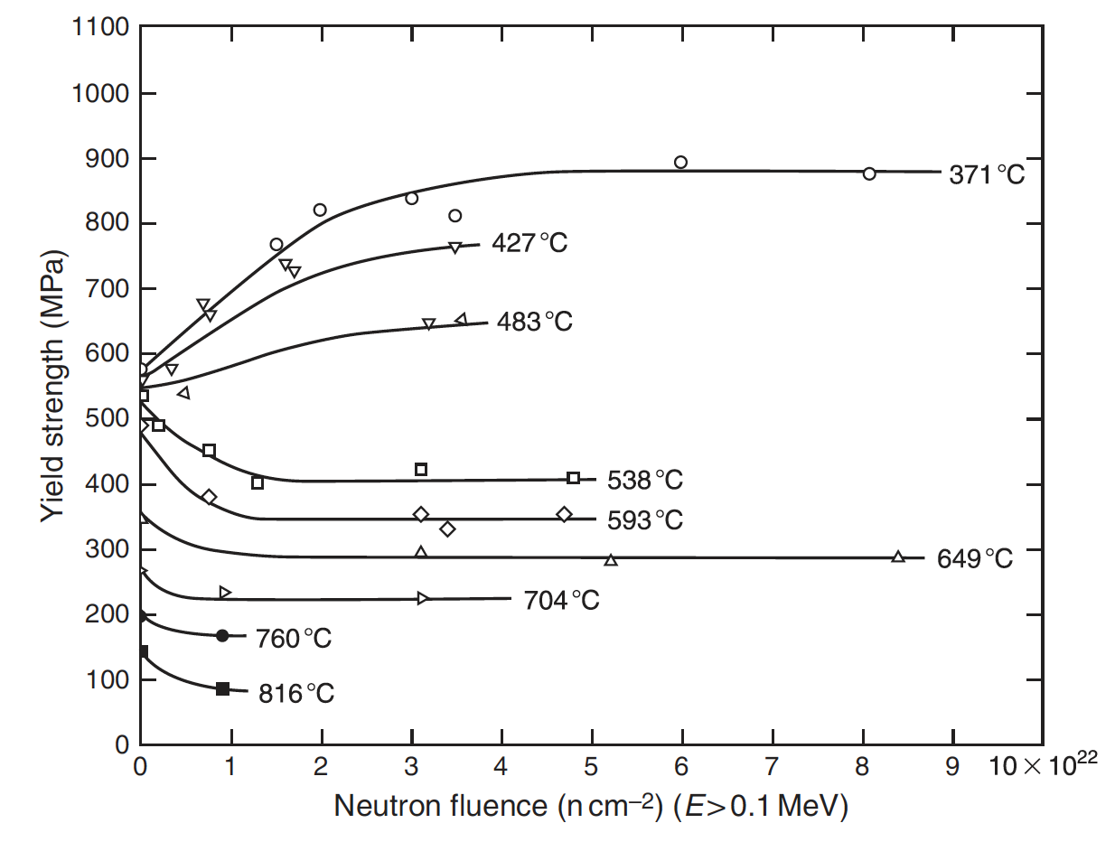
The need for advanced cladding
High fluence can also provide significant radiation hardening, coupled with severe losses in ductility
In addition to high fluence, relatively high temperature contributes to void swelling
AuSS appreciably weakens with increasing temperature
Thus, their applicability is limited in advanced reactor systems where high dose and high temperature are present

Slide 5
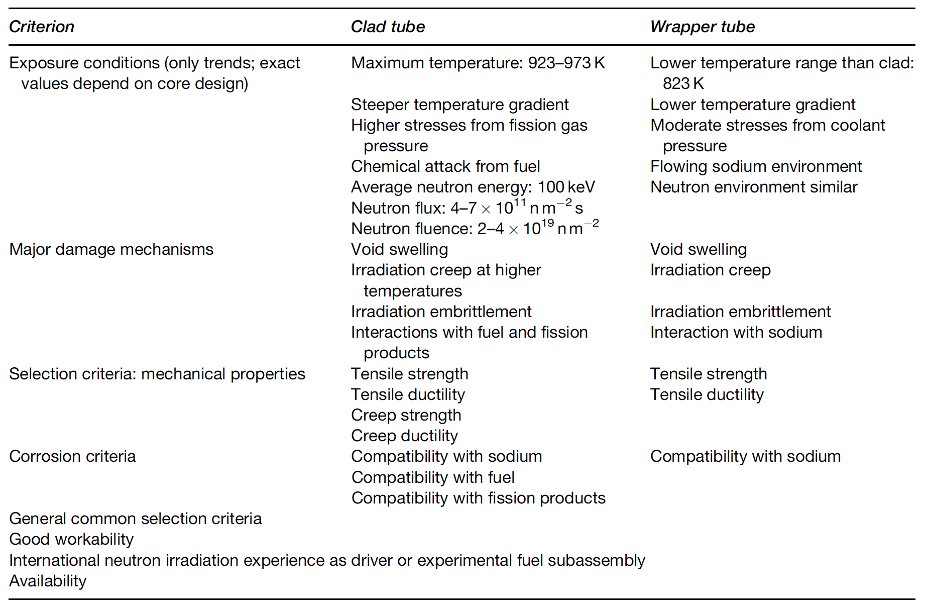
Fast Reactor Conditions
The structural components experience a different environment in advanced fast reactors than those in commercial LWRs
Key phenomena include void swelling, irradiation growth, irradiation hardening, irradiation creep, and helium embrittlement

Slide 6
Ferritic-Martensitic Steels

Slide 7
Ferritic-Martensitic Steels
The advanced ferritic–martensitic steels of current interest have evolved from creep-resistant ferritic steels
Subsequent developments through different levels of Cr and Mo have led to the current ferritic–martensitic steels: 9–12% Cr–Mo steels
F-M steels have advantageous mechanical properties, are relatively cheap, and control of their microstructure can be performed with heat treatments
F-M steels generally have worse high T mechanical properties than austenitic steels, especially creep life and irradiation creep resistance

Slide 8
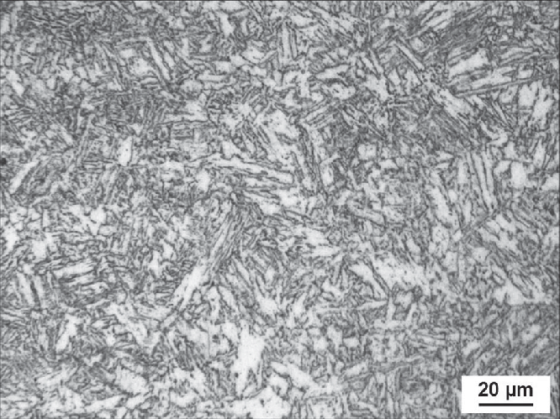
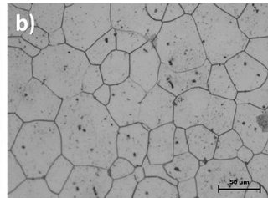
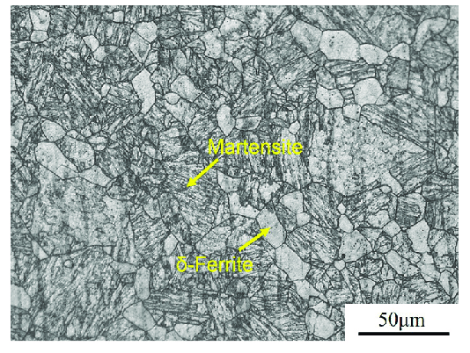
Crystal and Microstructures
alpha-Fe: ferrite, bcc
gamma-Fe: austenite, fcc
delta-Fe: high temperature ferrite, bcc
martensite: C-rich bct
pearlite: lamellar combination of ferrite and cementite (Fe3C)
also upper and lower bainite: don’t worry about it
alpha’: Cr rich ferrite (mainly induced via thermal aging)
martensite
ferrite
ferrite-martensite

Slide 9
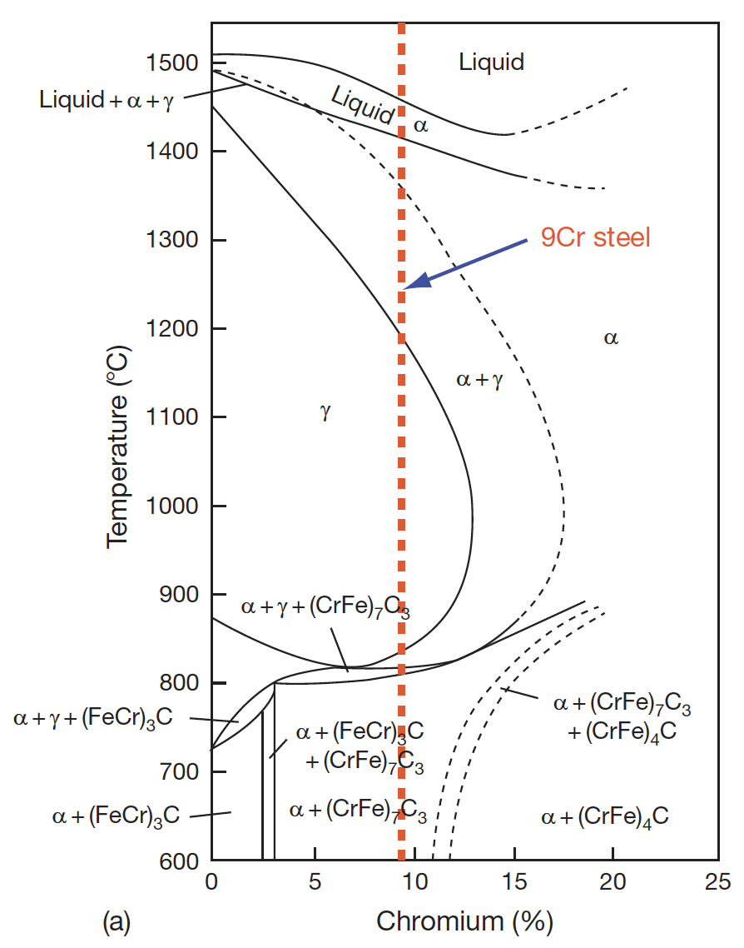
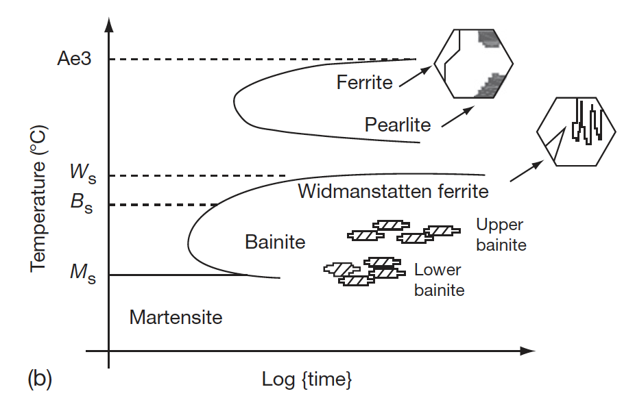
Ferritic-Martensitic Steels
The ability to retain ferrite is dependent upon the alloying elements and the heat treatments
In addition to Cr and Mo, the amount of Si, V, and C affect the phase boundaries
Accordingly, the 9-12% Cr/Mo family of steels can either be martensitic (9Cr–1MoVNb: T91) or ferritic-martensitic (12Cr–1MoVW: HT9; 9Cr–2Mo–V–Nb: EM12) steel
TTT diagram of austenite
Pseudo-binary phase diagram with Cr equivalent

Slide 10
Composition Effects
The development of 9Cr-Mo steels was initially focused on oxidation resistance and creep strength
The optimized initial alloy composition considered was 9Cr, 2Mo, 1W, 0.5Si, with C, B, V, Nb, and Ta in small amounts
A reduction in Cr content lowers the oxidation resistance
Higher Cr content has two effects, 1) it increases the hardenability by leading to the formation of martensite, and 2) promotes the formation of δ-ferrite, reducing the toughness
If the W+Mo concentration is kept <3%, creep strength will reduce, while higher amount promotes the formation of δ-ferrite and brittle Fe2Mo Laves phase

Slide 11
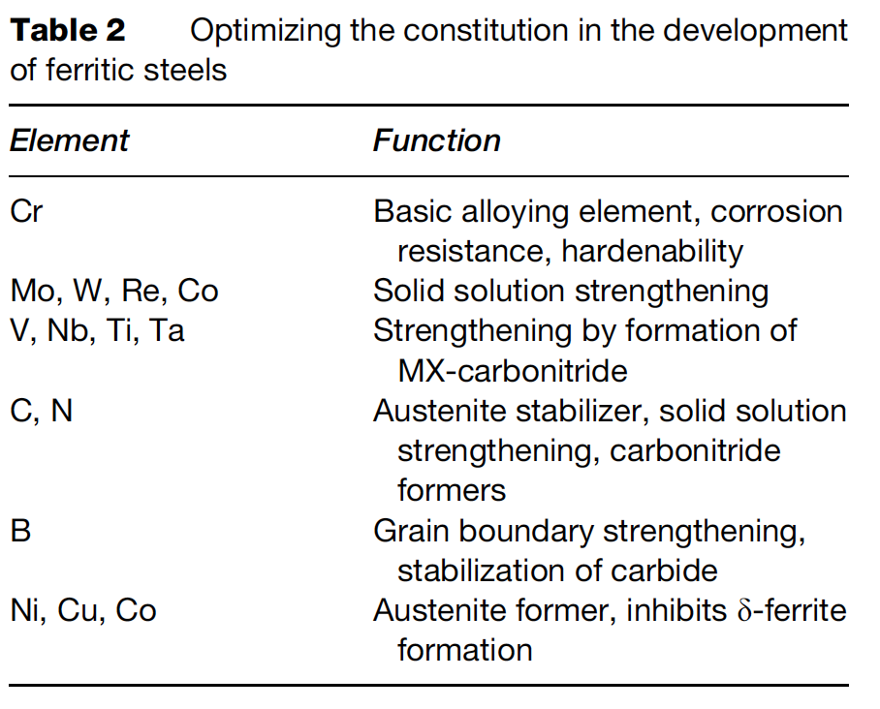
Composition Optimization
The addition or replacement of Mo with W and B increases the stability of M23C6
Lower Ni content introduces δ-ferrite, while its increase reduces creep strength
Lower Si reduces oxidation resistance, while higher Si content leads to agglomeration of carbides
The composition of all other elements can be optimized, based on structure–property correlation studies

Slide 12
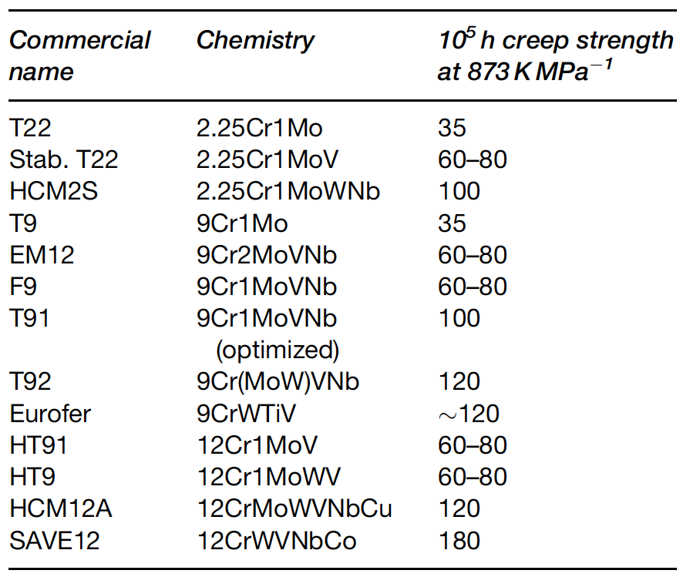
Composition Optimization for Creep
The development of high creep-rupture strength steels is based on optimizing the composition, δ-ferrite content, increasing the stability of the martensite, dislocation structure, and maximizing the solid solution and precipitation hardening
Based upon this property tailoring, a large number of alloys have been developed over the last 75 years
Reduced activation ferritic-martensitic (RAFM) steels steels have been developed in order to make concentrations of high activation residual elements lower

Slide 13
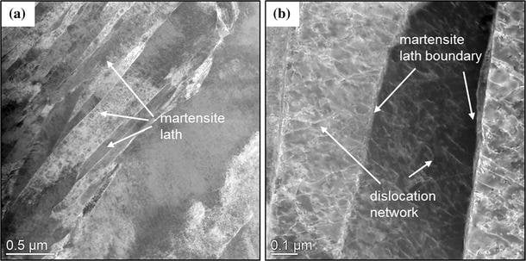
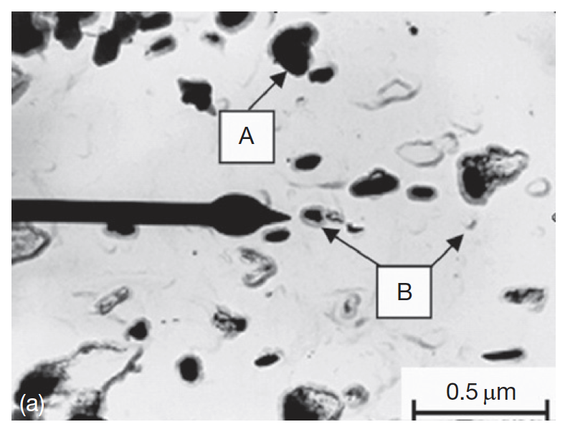
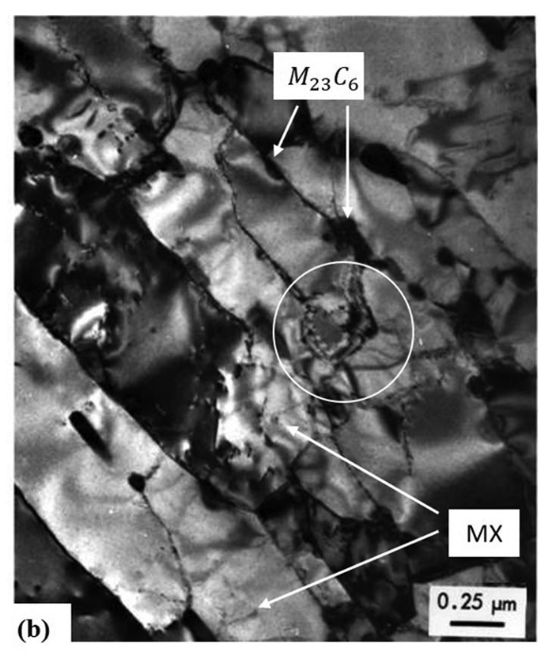
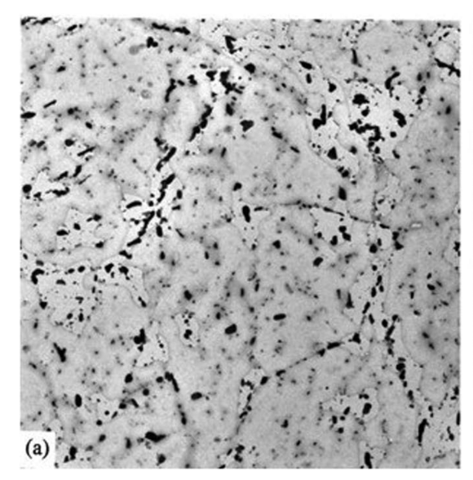
Microstructure
The microstructure of the steels consists of i) martensite laths containing dislocations; ii) coarse M23C6 particles located at prior austenite and ferrite grain boundaries; iii) finer carbide precipitates found within the laths and at the lath/subgrain boundaries
M2X or MX precipitates rich in Cr also form

Slide 14
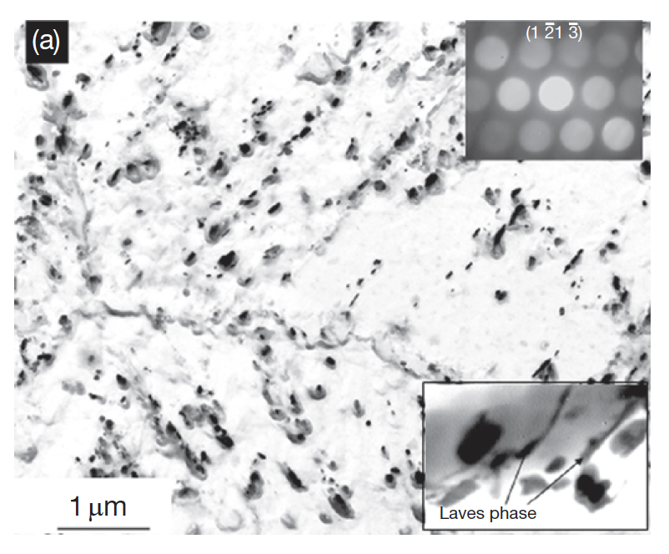
Microstructure
In reactor, this microstructure will change, with the M2X precipitates being replaced by MX intermetallic and Laves phases due to long exposure to high temperature
There are three types of processes with respect to evolution of secondary phases: irradiation-induced precipitation, irradiation-enhanced transformations, and the irradiation modified phases
The evolution of these phases depends on the composition and structure of the steel and the irradiation parameters like the temperature and fluence
Fe2Mo Laves intermetallic phase around the M23C6

Slide 15
Radiation Damage
Dislocation loops are the primary defect species observed
Loops are typically larger and with a lower number density as the irradiation temperature is increased
Loop size and density are increased as a function of dose, with loop density potentially saturating at 10 dpa
Voids can also form above 400C
Radiation-induced segregation can occur in these steels, but has been significantly less studied than in austenitic steels
General consensus that Cr is depleted at interfaces (at high T), and Ni, Si , and P are enriched at sinks
RIS appears to be dependent on both irradiation dose and temperature

Slide 16
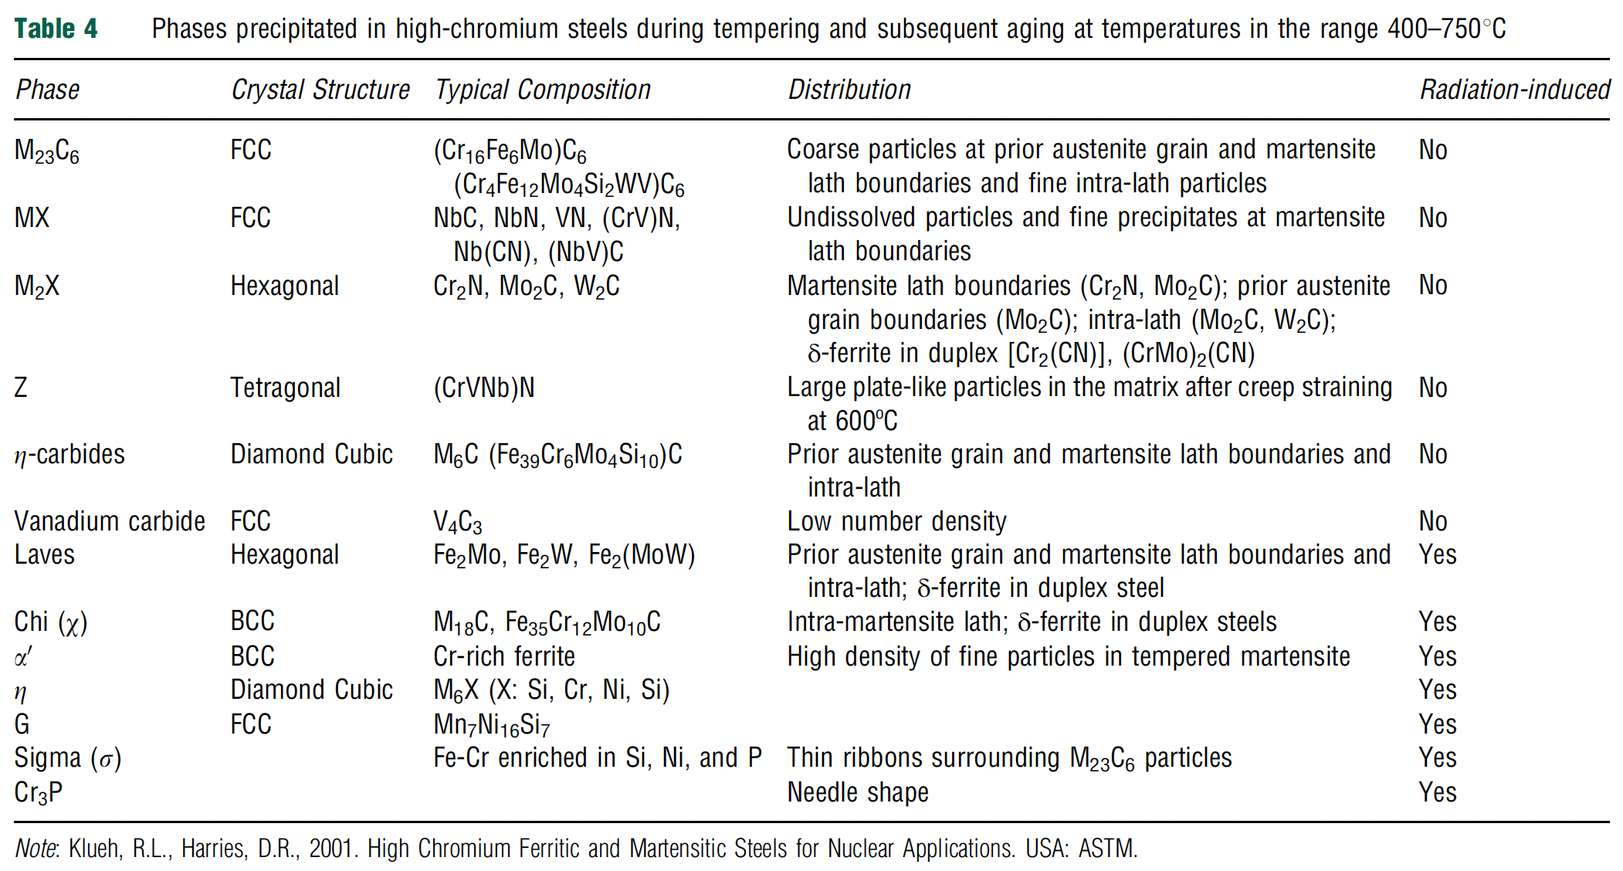
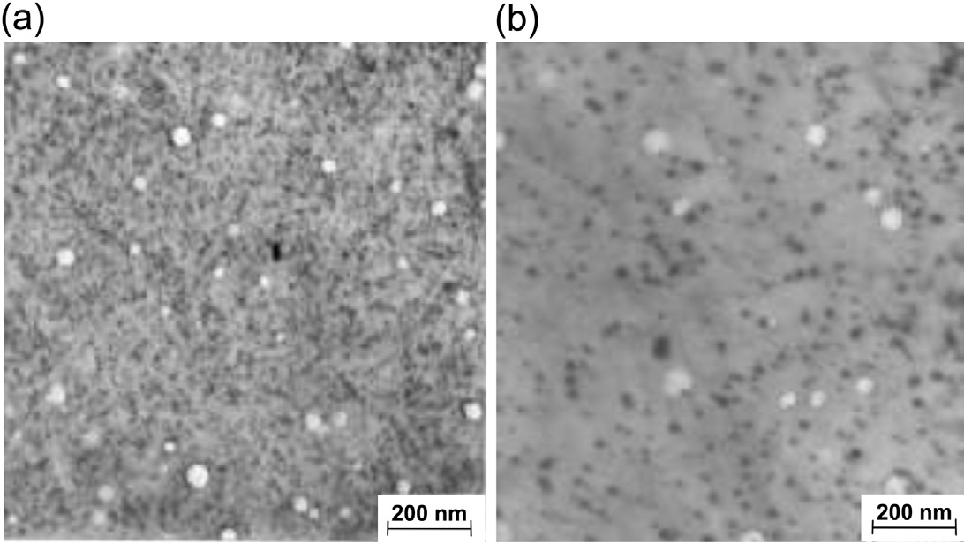
Phase Precipitation
Thermal processing will lead to precipitation, which affects the mechanical properties
Most of the carbon forms in M23C6 precipitates, which increase strength and reduce ductility
RIS leading to Cr depletion increases the matrix Cr composition and can lead to alpha’ formation, which embrittles the material
Chi, G, and sigma phases are enriched in Si and Ni and can nucleate at interfaces
alpha’
chi

Slide 17
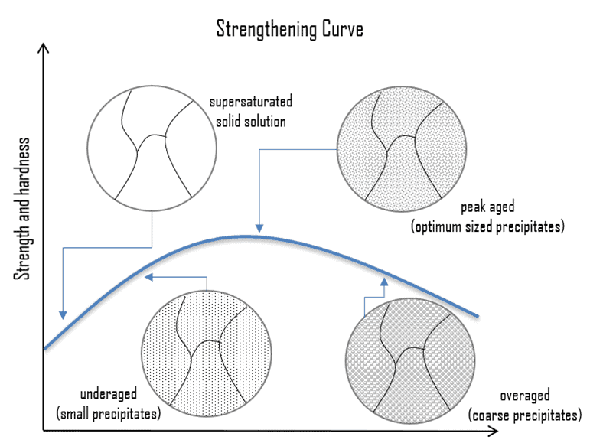
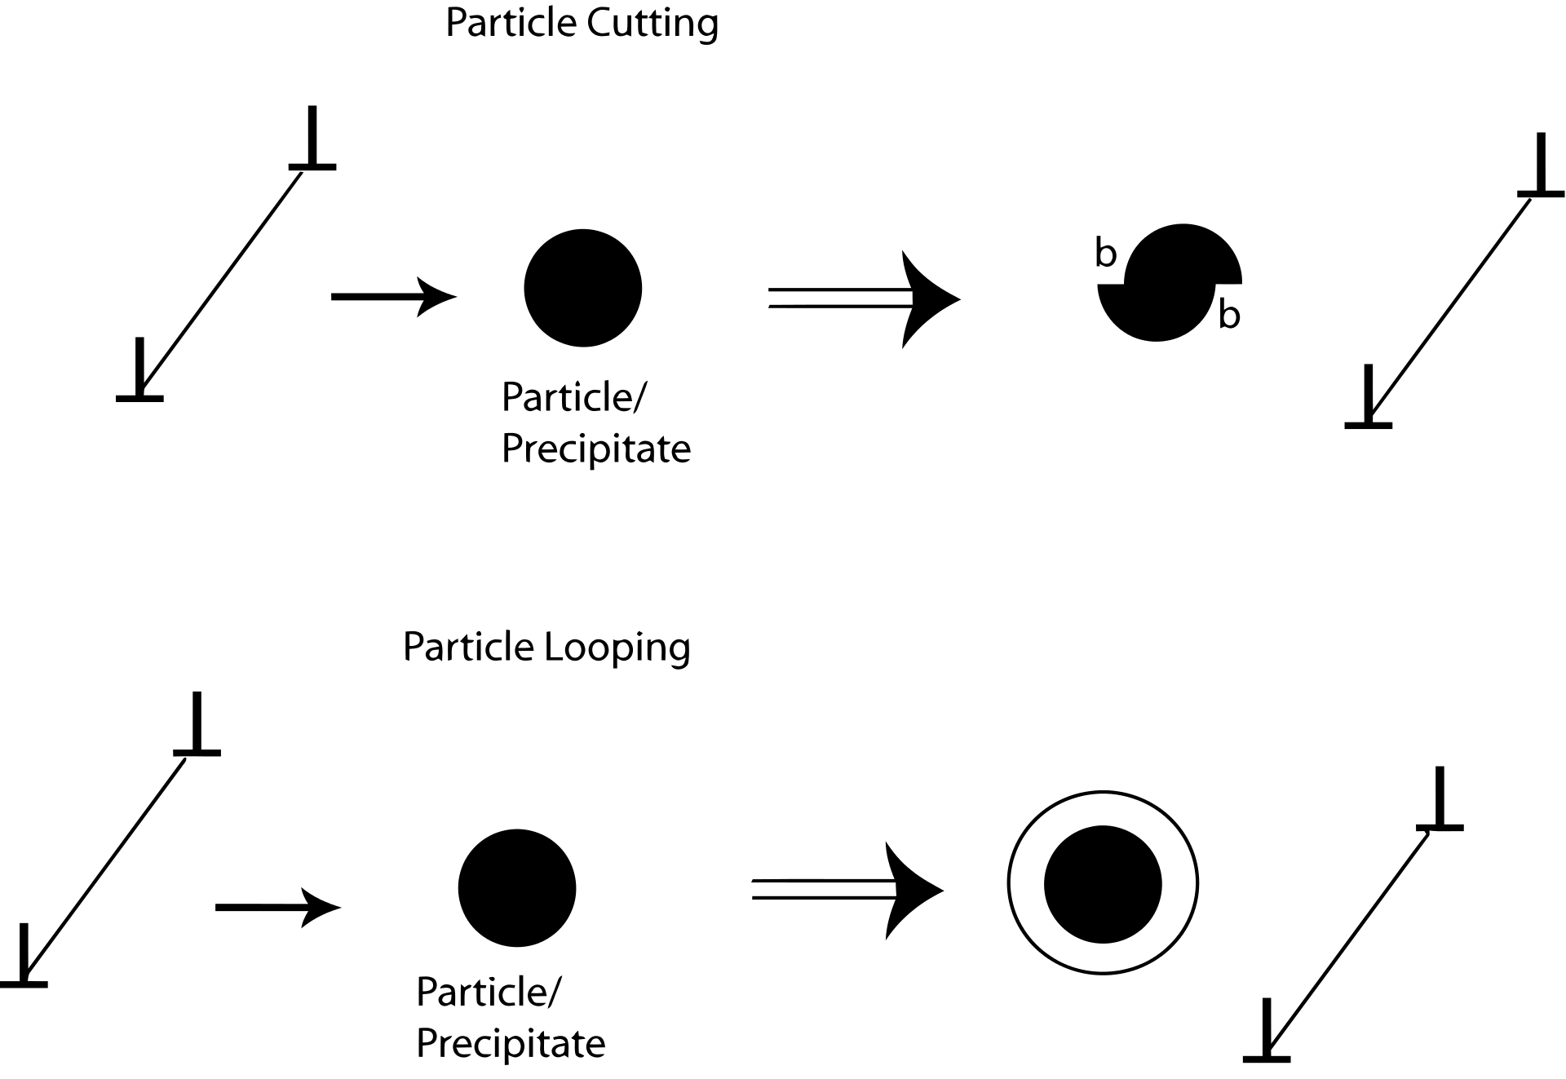
Precipitate Hardening
Precipitation hardening relies on changes in solid solubility with temperature to produce fine particles of an impurity phase which impedes the movement of dislocations
Since dislocations are often the dominant carriers of plasticity, this serves to harden the material

Slide 18
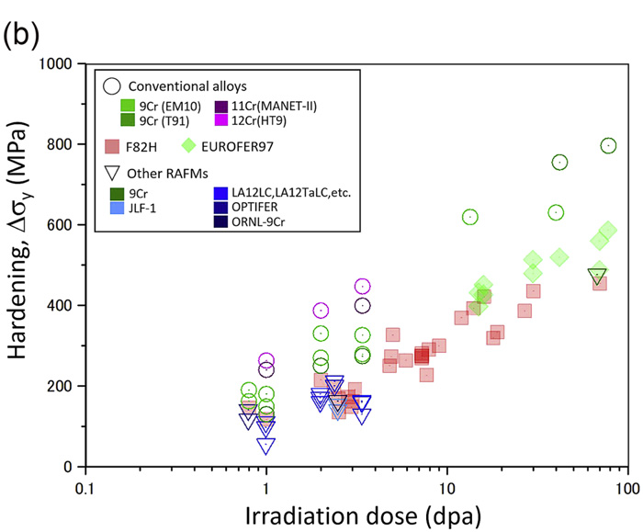
Irradiation Hardening
Microstructure changes lead to irradiation hardening of the steel
High amounts of carbon in 12% Cr steels leads to a large amount of precipitation, up to twice as much as 9% Cr steels
This high carbon content is needed to use steels as martensite
Both the steels have mainly M23C6 carbides with a small fraction of monocarbides
This high concentration of precipitates can eventually lead to brittle failure
The critical stress is inversely proportional to the crack length, crack length is equal to the diameter of the carbide precipitate, thus fracture stress also decreases with increasing precipitate size

Slide 19
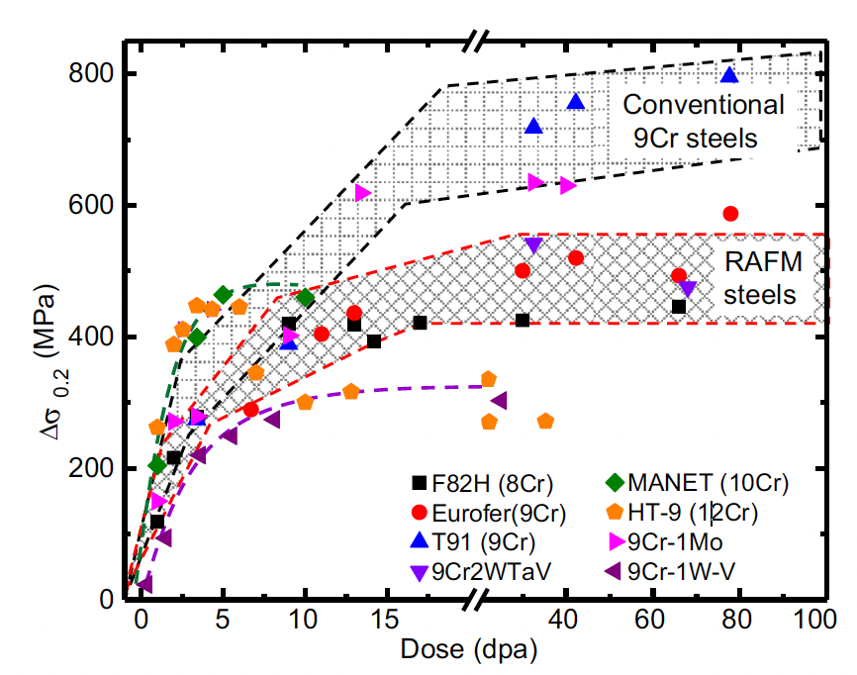
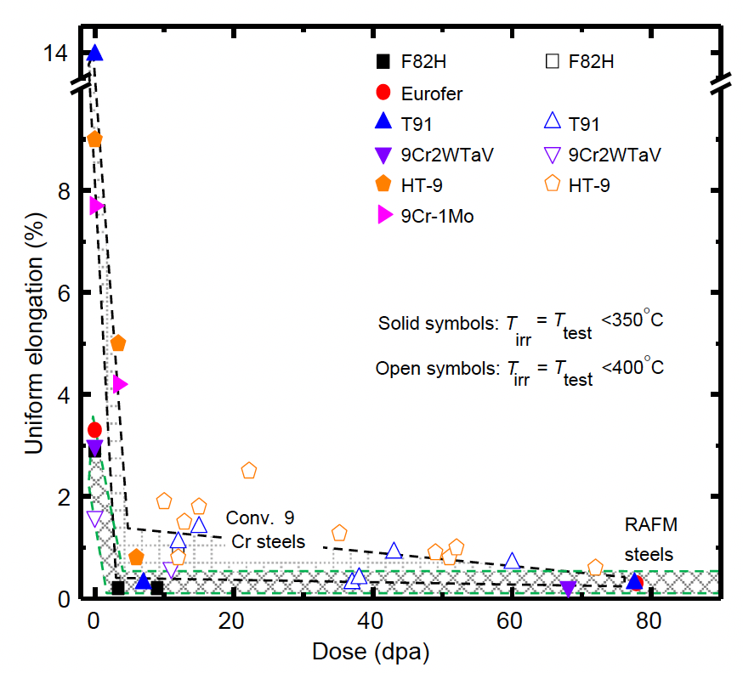
Irradiation Hardening
The increase in density of point defects clusters, dislocation loops, and second phases can result in a significant increase in yield stress in the first 5-10 dpa
For irradiations to higher doses, the increase in yield strength saturates because the defects begin to annihilate each other as steady-state defect concentrations are produced
In conjunction with the increase in yield strength, a significant reduction in uniform elongation is observed
A sharp drop to less than 2% elongation is observed after only a few dpa
These are for low T irradiations, less than 400C

Slide 20
Irradiation Creep Resistance
Irradiation creep resistance needs a good combination of thermal creep behavior and long-term microstructural stability at high temperature
In order to fabricate creep resistant steels, you design to have a number of microstructural features that are present
  Introduce high dislocation density to increase the strength of the basic lattice
  Strengthen the host lattice by solid solution strengtheners or defects
  Stabilize the boundaries created by phase transformations by precipitating carbides along the boundaries
  Arrest dislocation glide and climb by selection of crystal structure, solid solution, interfaces, dislocation interactions
  Resist sliding of grain boundaries by introducing special types of boundaries and anchoring the boundaries with precipitates

Slide 21
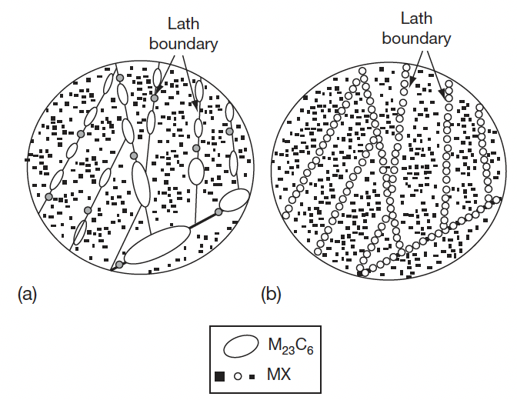
Irradiation Creep Resistance
Ensure long-term stability of the microstructure, especially against recovery and coarsening of the fine second phase particles
In the case of 9–12 Cr steels, the martensitic lath structure decorated with only MX which should be stable over long-term service life and is the most desired structure
MX can be stabilized over M23C6 by reducing the carbon content, but we need high amounts of C to have appropriate high temperature behavior and suppress ferrite
undesirable
desirable

Slide 22
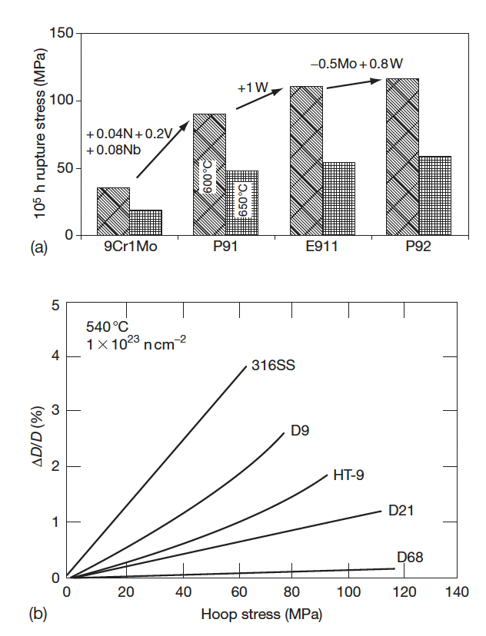
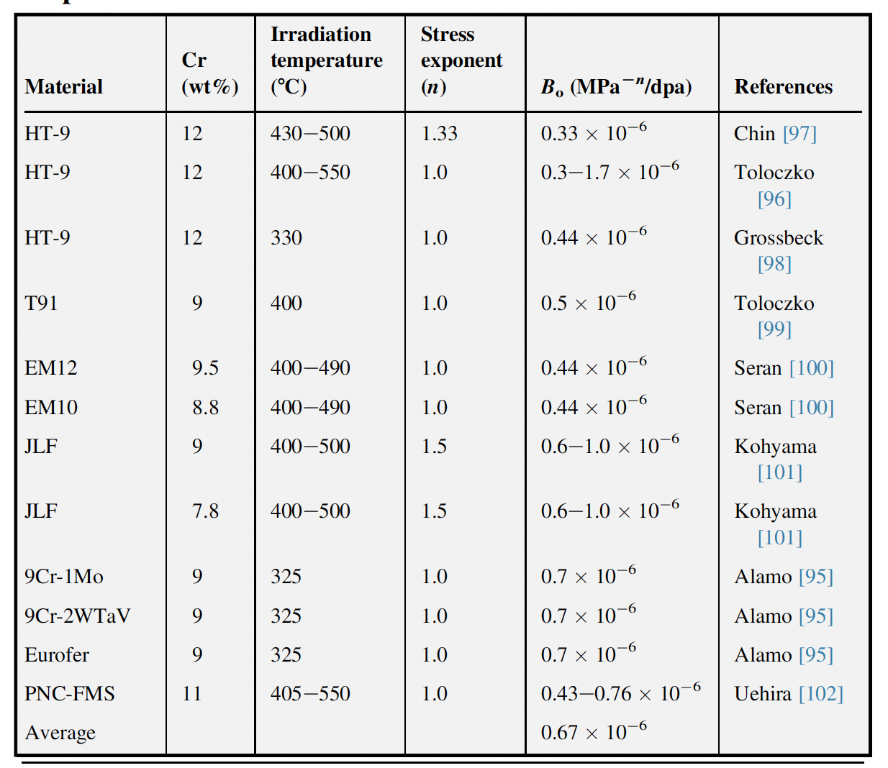

Irradiation Creep Resistance
Thermal Creep
So careful tailoring of alloying elements has led to improvement of the creep strength
Thermal creep behavior provides a starting point, which can then be refined by studying creep under irradiation
The irradiation creep depends on the stress level, the temperature, and the dose
Irradiation Creep

Slide 23
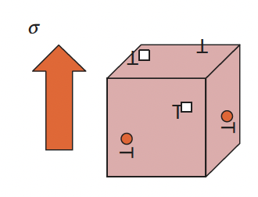
Irradiation Creep Resistance
The excess point defects precipitate into either interstitial or vacancy loops, but not randomly
The interaction between point defects and stress leads to the precipitation of interstitial loops parallel to the applied stress, while vacancy loops form in planes perpendicular to the stress: stress-induced preferential nucleation (SIPN)
Under applied stress, the vacancies migrate preferentially to grain boundaries perpendicular to the applied stress, while the interstitials move toward boundaries parallel to the stress: stress-induced preferential absorption (SIPA)
SIPN
SIPA

Slide 24
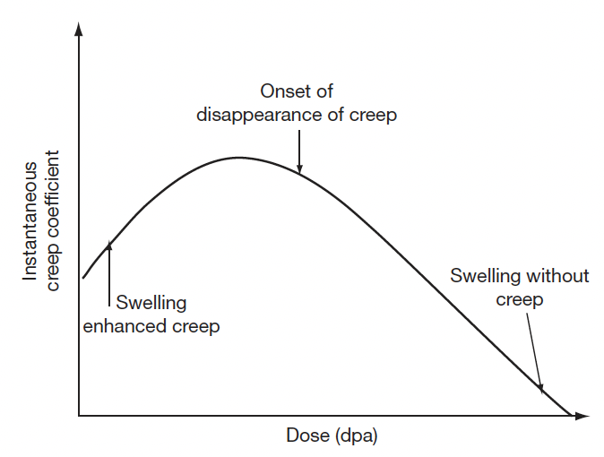
Creep Evolution
The radiation-induced defects also evolve from isolated point defect to loops and voids, which have different types of influence on irradiation creep
Irradiation creep occurs simultaneously with swelling and swelling can influence irradiation creep
At very small dose levels, swelling enhances creep rates; beyond a certain dose level the creep component reduces; at high dose levels creep disappears, while swelling continues

Slide 25
Irradiation Embrittlement
F/M steels have a large number of monocarbides which aid in creep resistance
The lath boundaries are decorated with Cr rich M23C6 precipitates which increase the thermal stability
Embrittlement is caused by 1) segregation of elements to lath boundaries which make the grain boundaries decohesive, and 2) evolution of carbides and intermetallic phases
For removable components such as cladding, which are subjected to high temperature and pressure with a residence time of a few years, creep is the issue which decides their design and performance
For permanent support structures increase in hardening and loss in fracture toughness on irradiation are major issues

Slide 26
Irradiation Embrittlement
The increase in the ductile to brittle transition temperature, DBTT, is known to be related to irradiation hardening, which is generally observed to saturate with fluence
Evidence for a possible maximum in DBTT was observed for the 12Cr steel irradiated in the range of 35–100 dpa in the FFTF
High fluence and/or high temperature are required before a maximum is observed
Thus, these properties are a balance between the point defect production and irradiation-induced precipitation
The precipitation during irradiation hardens the steel and irradiation accelerated recovery and aging soften the steel
The high temperature recovery produces an observable saturation in hardening above ~720K

